Slide 1
Introduction to digital marketing

Slide 2

Meet Rohan – The Aspiring Entrepreneur
Rohan, a young MBA graduate, always dreamed of starting his own sneaker brand. Inspired by global giants like Nike and Adidas, he launched "StrideX", an online store selling premium sneakers.
Excited about his product, he set up a small shop in his city and relied on traditional marketing—newspaper ads, flyers, and word-of-mouth. Weeks passed, but sales remained low. Foot traffic was limited, and he couldn’t reach sneaker enthusiasts outside his city.
Frustrated, Rohan met his mentor, Priya, a successful digital marketer. She asked, "How many people see your newspaper ad?" Rohan hesitated, "I have no idea."
Priya smiled, "That’s where digital marketing changes the game."

Slide 3
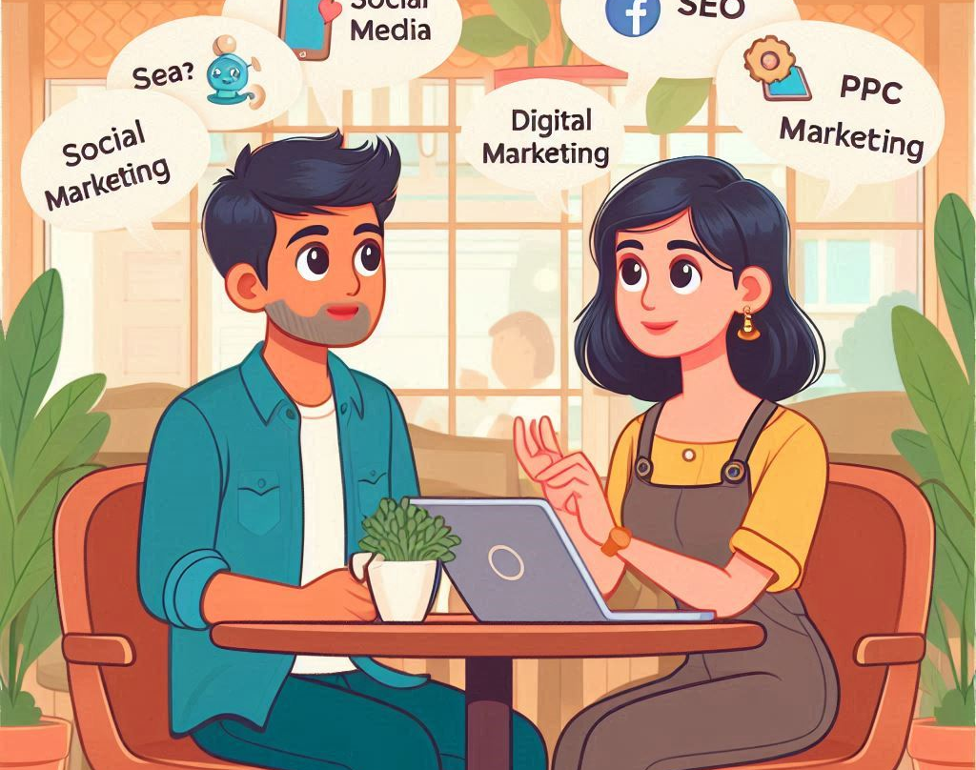
What is Digital Marketing?
Priya explained: "Digital marketing is the use of online platforms like search engines, social media, email, and websites to promote a brand, connect with customers, and drive sales."
Unlike traditional marketing, where businesses hope their ads are seen, digital marketing allows precise targeting.
She showed Rohan an example: 🔹 Instead of printing 1,000 flyers and hoping people read them, he could create an Instagram ad that reaches 10,000 sneaker lovers for half the cost.

Slide 4
Why Digital Marketing? (Priya’s Lessons)
Priya listed five reasons why businesses today must use digital marketing:
1️⃣ Wider Reach:
His shop could only serve people in his city.
Digital marketing could make StrideX visible across India (or globally!).
2️⃣ Cost-Effective:
Flyers and newspaper ads cost a lot with no guarantee of results.
A ₹500 Facebook ad could bring thousands of visitors to his online store.
3️⃣ Measurable Results:
With digital marketing, he could track how many people clicked, viewed, or bought sneakers.
4️⃣ Targeted Advertising:
Instead of advertising to everyone, he could show ads only to sneaker lovers aged 18-35.
5️⃣ Customer Engagement:
Unlike one-way newspaper ads, social media allowed StrideX to interact with customers.

Slide 5
Traditional Marketing vs. Digital Marketing
Rohan was curious. "So, is traditional marketing useless?"
Priya shook her head. "Not at all! It depends on your audience. But digital marketing offers more control, better targeting, and instant feedback."
Aspect | Traditional Marketing | Digital Marketing
Medium | Newspapers, TV, radio | Social media, websites, email
Audience Targeting | Broad, less specific | Highly targeted ads
Cost | High (printing, air-time) | Cost-effective
Measurability | Hard to track | Real-time analytics available
Interaction | One-way communication | Two-way engagement with users

Slide 6

The Evolution of Digital Marketing
Priya pulled out her phone and showed Rohan how marketing had evolved:
📌 1990s: Businesses started making websites and email marketing became popular. 📌 2000s: Google launched AdWords, Facebook emerged, and SEO became a game-changer. 📌 2010s: Social media exploded—Instagram, YouTube, influencer marketing, and data-driven ads. 📌 2020s: AI-driven marketing, chatbots, and hyper-personalization became the future.

Slide 7
Case Study – Nike’s Digital Marketing Success
To convince Rohan, Priya shared an example:
✅ Brand: Nike ✅ Strategy:
Used SEO to rank on Google for “best running shoes.”
Partnered with athletes & influencers for social media marketing.
Created interactive campaigns like the Nike Training App.
Used Facebook & Instagram Ads to target fitness enthusiasts.
✅ Result: Nike’s digital marketing helped them dominate online sneaker sales.

Slide 8
Rohan’s Realization
Rohan finally understood—if he wanted StrideX to succeed, he needed to go digital.
He asked, "Where do I start?" Priya smiled, "Let’s begin with the key channels of digital marketing."

Slide 9
Key Digital Marketing Channels – Rohan’s Next Lesson
Rohan’s Dilemma
Now that Rohan understood the power of digital marketing, he asked Priya, “Okay, I get it. But where do I start? Should I just post on Instagram?”
Priya smiled, “Good question! Digital marketing isn’t just about social media. There are multiple channels, and you need to pick the right ones for your brand.”
She pulled out her tab and started scribbling down the six key digital marketing channels every business should know:

Slide 10
1️⃣ Search Engine Optimization (SEO) – Be Found on Google
Example: "Imagine someone searches ‘best running shoes under ₹5000’ on Google. If StrideX’s website appears on top, that’s because of SEO!"
✅ SEO helps businesses rank higher on search engines (Google, Bing, etc.). ✅ More visibility → More website visitors → More sales! ✅ Requires keyword research, quality content, and a well-structured website.
Priya’s Advice: "SEO is a long-term strategy. It takes time but gives free organic traffic."
Rohan was excited. “So, if I use the right words on my website, I can attract sneaker buyers?” Priya nodded, “Exactly! But SEO is just one piece of the puzzle.”

Slide 11
2️⃣ Pay-Per-Click (PPC) Advertising – Instant Visibility
Example: "If you want immediate results, you can pay to appear at the top of Google results."
✅ Google Ads and Facebook Ads allow businesses to show paid ads to potential customers. ✅ You only pay when someone clicks your ad (hence ‘Pay-Per-Click’). ✅ Best for quick traffic, but costs money.
Rohan asked, “So, I can pay to get my website at the top?” Priya nodded, “Yes! But a smart strategy is to combine SEO (free, long-term) and PPC (paid, instant).”

Slide 12
3️⃣ Social Media Marketing – Build a Brand Community
Priya asked, “Rohan, where do you think your customers spend most of their time?” Rohan thought for a moment and said, “Instagram and YouTube?”
Priya smiled, “Exactly! Social media is one of the most powerful ways to connect with your audience.”
✅ Platforms: Facebook, Instagram, LinkedIn, Twitter, YouTube, TikTok. ✅ You can promote products, engage with customers, and run ads. ✅ Influencer collaborations boost brand awareness.
Example: "Nike partners with athletes & influencers on Instagram to promote new sneaker launches."
Rohan asked, “How often should I post?” Priya replied, “Consistency is key! Post engaging content 3-4 times a week.”

Slide 13
4️⃣ Content Marketing – Attract Customers with Valuable Content
Example: "Instead of just selling sneakers, StrideX could start a blog on ‘How to Pick the Perfect Running Shoes’ or a YouTube channel reviewing sneakers."
✅ Content marketing involves blogs, videos, infographics, podcasts, and more. ✅ It builds trust and positions you as an industry expert. ✅ Good content improves SEO and brings organic traffic.
Priya’s Tip: “Instead of saying ‘Buy my sneakers,’ educate your audience. If they trust you, they will buy!”

Slide 14
5️⃣ Email Marketing – Personal Connection with Customers
Priya asked, “Do you check promotional emails?” Rohan replied, “Only if they have discounts!”
Priya laughed, “Exactly! Email marketing is great for nurturing leads and increasing repeat sales.”
✅ Businesses collect emails and send personalized offers, newsletters, and updates. ✅ Automated emails (cart abandonment, discounts) boost sales.
Example: "StrideX could send a ‘20% Off for First-Time Buyers’ email to new subscribers."

Slide 15
6️⃣ Affiliate & Influencer Marketing – Leverage Others to Promote Your Brand
Priya asked, “Would you trust an ad or a friend’s recommendation more?” Rohan replied, “Definitely a friend’s recommendation.”
✅ Affiliate marketing: Businesses pay commissions to people who bring sales. ✅ Influencer marketing: Brands partner with social media influencers to promote products. ✅ Great for reaching a wider audience.
Example: "StrideX could collaborate with a YouTuber who reviews sneakers. If they recommend StrideX, their followers are more likely to buy."

Slide 16
Which Channels Should Rohan Focus On?
Priya said, "Now that you know the channels, you need to pick the best ones for your business."
🚀 For a new brand like StrideX: ✅ SEO (for long-term free traffic) ✅ Social Media Marketing (to build a community) ✅ PPC Ads (for instant visibility) ✅ Influencer Marketing (to gain trust quickly)
Rohan smiled, “This makes sense! Instead of doing everything, I’ll focus on these four first.”
Priya nodded, “Good choice! Next, let’s understand how these channels fit into the Digital Marketing Funnel.”

Slide 17
Understanding the Digital Marketing Funnel – Rohan’s Strategy Blueprint
Rohan was feeling pumped! He had a solid understanding of digital marketing channels, but he had one burning question.
“Priya, I get that I need SEO, social media, and ads, but how do I actually turn strangers into customers?”
Priya grinned. “Great question! You need a Digital Marketing Funnel.”
She pulled out a notepad and drew a funnel.

Slide 18
Understanding the Digital Marketing Funnel – Rohan’s Strategy Blueprint
Priya explained, “A funnel represents the journey of a customer from the moment they first hear about your brand to the point they make a purchase.”
She pointed to different sections of the funnel:
1️⃣ Awareness – "Who are you?" 2️⃣ Interest – "Hmm, this looks interesting!" 3️⃣ Consideration – "Should I buy it?" 4️⃣ Conversion – "I’m buying it!" 5️⃣ Loyalty & Advocacy – "I love this brand!"
Rohan nodded, “So, I can’t just throw ads and expect people to buy? They need to trust me first?”
Priya smiled, “Exactly! Let’s break down each stage with your company.”

Slide 19
1️⃣ Awareness Stage – “Who are you?”
🔹 Goal: Get StrideX in front of potential sneaker buyers. 🔹 Channels to use: ✅ SEO – Writing blog articles like “Top 5 Sneakers for Running in 2025” ✅ Social Media – Posting engaging reels on Instagram and TikTok ✅ PPC Ads – Running Google & Facebook ads targeting running enthusiasts ✅ Influencer Marketing – Collaborating with fitness YouTubers
Example: "Imagine someone scrolling Instagram and seeing a fun reel about StrideX’s ultra-lightweight sneakers. That’s awareness!"
Priya’s Tip: “At this stage, you don’t sell. You just make people aware of your brand.”

Slide 20
2️⃣ Interest Stage – “Hmm, this looks interesting!”
🔹 Goal: Engage users and make them curious about StrideX.
🔹 Channels to use:
✅ Social Media – Posting behind-the-
scenes videos on sneaker design
✅ Content Marketing – Writing articles like “How
to Choose the Right Sneakers”
✅ Email Marketing – Capturing leads through newsletter sign-ups
Example: "A visitor reads an article on StrideX’s website about the best sneakers for long-distance running. They like the insights and sign up for a free sneaker-buying guide."
Priya’s Tip: “Here, you educate and engage. Don’t push for sales yet.”

Slide 21
3️⃣ Consideration Stage – “Should I buy it?”
🔹 Goal: Convince potential customers why StrideX is better than competitors.
🔹 Channels to use:
✅ Retargeting Ads – Showing ads to people who visited the website but didn’t buy ✅ Email Marketing – Sending product comparisons & reviews ✅ Influencer Testimonials – Posting reviews from athletes & YouTubers
Example: "A potential customer saw StrideX on Instagram but didn’t buy. The next day, they see an ad: ‘StrideX vs. Nike: Which is better for runners?’ They click to read more."
Priya’s Tip: “At this stage, you must highlight your USP (Unique Selling Proposition). Why should they choose you?”

Slide 22
4️⃣ Conversion Stage – “I’m buying it!”
🔹 Goal: Get the visitor to purchase. 🔹 Channels to use: ✅ Discount Offers – Giving a ‘10% Off First Order’ promo code
✅ Free Shipping – Reducing hesitation with free delivery
✅ Scarcity & Urgency – “Only 5 sneakers left in stock!”
Example: "The visitor gets an email: ‘Limited Time Offer – 15% Off StrideX Sneakers! Use Code: RUN15’. They finally make the purchase!"
Priya’s Tip: “People need a push to convert. Discounts, social proof, and urgency work wonders.”

Slide 23
5️⃣ Loyalty & Advocacy Stage – “I love this brand!”
🔹 Goal: Turn customers into repeat buyers and brand ambassadors. 🔹 Channels to use: ✅ Loyalty Programs – Rewarding returning customers with discounts ✅ Referral Programs – Giving benefits for referring friends ✅ User-Generated Content – Encouraging buyers to share their sneaker experience on social media
Example: "StrideX sends an email: ‘Refer a friend and get ₹500 off your next pair!’ The customer shares their referral link."
Priya’s Tip: “Loyal customers are your best marketers. Keep them engaged!”

Slide 24
Rohan’s game plan.
Rohan stared at the funnel sketch, excited.
“So, instead of asking people to buy right away, I should guide them step by step?”
Priya nodded. “Yes! The best brands don’t sell, they build relationships.”
🚀 Action Plan for StrideX: ✔ Awareness – Start Instagram & YouTube marketing ✔ Interest – Write sneaker-related blog posts & collect emails ✔ Consideration – Show testimonials & product comparisons ✔ Conversion – Use discounts & retargeting ads ✔ Loyalty – Launch a referral program
Rohan grinned, “I love this! Let’s build StrideX’s funnel.”
Priya smiled, “Now, before we implement this, let’s analyze a real-world case study to see the funnel in action.”

Slide 25
Rohan’s game plan.
Priya and Rohan sit at a quiet corner of the café, her laptop open in front of them.
Priya: "Before we apply the funnel to StrideX, let’s study a brand that successfully used digital marketing to grow."
She clicks on a presentation and pulls up a case study of Nike’s digital marketing strategy.
Priya: "Nike follows the digital marketing funnel perfectly. Let’s break it down."
📌 Nike’s Digital Marketing Funnel in Action: 1️⃣ Awareness: They create buzz with influencer collaborations, viral campaigns, and YouTube ads. 2️⃣ Interest: They use engaging Instagram stories, behind-the-scenes videos, and interactive content. 3️⃣ Consideration: They showcase product reviews, comparisons, and user testimonials. 4️⃣ Conversion: They offer limited-time discounts and personalized shopping experiences. 5️⃣ Loyalty: They have the Nike Membership program with exclusive perks.
Rohan: (leaning in, impressed) "So they’re not just selling shoes—they’re creating a whole experience!"
Priya: "Exactly! Now, let’s map out a similar funnel for StrideX. What strategies can we use at each stage?"
Rohan: (grabbing a notebook, thinking hard) "For Awareness, we can start with Instagram and YouTube content. For Interest, maybe blog posts about sneaker care, trends, and styling tips. For Consideration, we’ll showcase testimonials and comparisons…"
Priya: (nodding, smiling) "Yes! And for Conversion, we’ll use discounts and retargeting ads. Finally, to build Loyalty, we can launch a referral program!"
🚀 StrideX Action Plan (Finalized): ✔ Awareness – Instagram & YouTube marketing ✔ Interest – Sneaker-related blog posts & email collection ✔ Consideration – Testimonials & product comparisons ✔ Conversion – Discounts & retargeting ads ✔ Loyalty – Referral program
Rohan grins, energized. "I love this! Let’s build StrideX’s funnel."
Priya: (closing her laptop) "Great! But before we jump into execution, you need the right tools and platforms. Let’s explore them next."

Slide 26
Equipping Rohan with the Right Tools
With a strategy in place, Priya introduces Rohan to key digital marketing tools that will help StrideX grow effectively. Instead of manually handling everything, these tools streamline content creation, advertising, and customer engagement.
1️⃣ Social Media Management
Automates scheduling and posting across platforms.
Tools: Meta Business Suite, Hootsuite, Buffer
2️⃣ SEO & Keyword Research
Finds the best search terms to improve website rankings.
Tools: Google Keyword Planner, Ahrefs, SEMrush

Slide 27
Equipping Rohan with the Right Tools
3️⃣ Content Creation & Design
Creates professional-looking visuals and videos.
Tools: Canva (for graphics), CapCut (for videos), Grammarly (for content editing)
4️⃣ Email Marketing
Automates email campaigns and newsletters.
Tools: Mailchimp, ConvertKit, HubSpot
5️⃣ Analytics & Tracking
Measures marketing performance to refine strategies.
Tools: Google Analytics (website tracking), Facebook Pixel (ad tracking)

Slide 28
🚀 Practical Implementation: StrideX’s First Digital Campaign
With the strategy and tools in place, it's time for action! Priya guides Rohan through launching StrideX’s first digital marketing campaign.
Step 1️⃣: Creating the First Social Media Post
Rohan starts with Instagram, using Canva to design an eye-catching post featuring StrideX’s latest sneakers.
Image: A dynamic shot of the sneakers in action
Caption: “🔥 Step Up Your Game with StrideX! 🔥 Comfort & style, all in one. Limited stock—grab yours now! #StrideWithPride”
Hashtags: #SneakerHeads #StreetStyle #LimitedEdition
Call to Action (CTA): “📥 DM us for exclusive launch discounts!”
📌 Why? Instagram is a high-engagement platform, and using hashtags expands reach.

Slide 29
🚀 Practical Implementation: StrideX’s First Digital Campaign
Step 2️⃣: Running a Paid Ad Campaign
Next, Priya helps Rohan set up his first Facebook & Instagram ad using Meta Ads Manager.
Target Audience: ✅ Age: 18-35 (sneaker enthusiasts) ✅ Location: Major cities with high sneaker culture ✅ Interests: Streetwear, Sneakers, Gym Enthusiasts
Budget: ₹500 per day for 7 days (test run)
Objective: Drive traffic to StrideX’s Instagram page
📌 Why? Paid ads accelerate brand awareness and help attract potential customers.

Slide 30
🚀 Practical Implementation: StrideX’s First Digital Campaign
Step 3️⃣: Setting Up an Email Campaign
To retain potential customers, Priya introduces Mailchimp to set up an email capture form on StrideX’s website.
Lead Magnet: A 10% discount code for signing up
Follow-up Emails: 1️⃣ Welcome Email: “Thanks for joining StrideX! Here’s your 10% OFF.” 2️⃣ Product Showcase: Featuring best-selling sneakers 3️⃣ Limited-Time Offer: Urging quick purchases
📌 Why? Email marketing helps build long-term customer relationships.

Slide 31
📊 Analyzing the Campaign Performance & Optimization
A week after launching StrideX’s first digital marketing campaign, Rohan and Priya sit down to analyze the results.
🔍 Step 1: Reviewing Social Media Engagement
Rohan checks Instagram Insights and Facebook Ads Manager to measure the success of their organic and paid posts.
Instagram Post Metrics:
✅ Likes: 1,200 ✅ Shares: 300 ✅ Comments: 150 (Many asking about sizes & price) ✅ Follower Growth: +500
Paid Ad Performance (₹3,500 spent in 7 days): ✅ Reach: 25,000 people ✅ Clicks: 3,000 (cost per click ₹1.16) ✅ Conversions: 45 purchases (₹2,250 average order value)
📌 Insights:
The engagement is high, which means people like the content.
Many people commented with questions—adding a chatbot for auto-replies might help.
The ad drove sales, making a 3x return on investment.

Slide 32
📊 Analyzing the Campaign Performance & Optimization
📧 Step 2: Checking Email Marketing Performance
Using Mailchimp Analytics, Priya and Rohan evaluate how well their email campaign worked.
Subscribers: 1,200 new signups
Open Rate: 42% (Industry average: 20%)
Click-through Rate: 18% (Industry average: 5%)
Sales from Email: 30 additional sneaker purchases
📌 Insights:
The welcome email had the highest open rate—offering a discount worked well!
The product showcase email had fewer clicks—needs more engaging content.
Personalizing emails with customer names and recommendations could improve results.

Slide 33
📊 Analyzing the Campaign Performance & Optimization
📈 Step 3: Website Traffic & Conversion Rate
Using Google Analytics, they review website performance.
Total Visits: 8,500
Bounce Rate: 60% (High—people leave quickly)
Average Session Time: 1 min 45 sec
Conversion Rate: 1.5% (Needs improvement)
📌 Insights:
High bounce rate means visitors leave quickly—maybe the homepage isn’t engaging enough.
Adding a product demo video or a limited-time discount pop-up could help.
Mobile traffic is 75%, so optimizing for mobile is crucial.

Slide 34
📊 Analyzing the Campaign Performance & Optimization
🛠 Step 4: Optimization Strategy
Priya suggests improvements based on their analysis:
🚀 For Social Media: ✔️ Add a chatbot to answer common queries instantly. ✔️ Experiment with Instagram Stories & Reels for better reach. ✔️ Use a carousel post to showcase different sneaker angles.
🚀 For Email Marketing: ✔️ Add customer names for personalized emails. ✔️ Create an exclusive VIP club for repeat buyers. ✔️ Use GIFs or short videos to make emails more engaging.
🚀 For Website Optimization: ✔️ Improve the homepage with high-quality visuals & product videos. ✔️ Add a time-limited discount pop-up to reduce bounce rates. ✔️ Optimize for faster mobile loading speed.

Slide 35
Assignment
Your own use case

Slide 36
📌 Assignment Use Case: Digital Marketing Strategy for "FitFuel"
👟 Background: A startup named FitFuel is launching a new protein bar aimed at fitness enthusiasts, gym-goers, and health-conscious individuals. Their goal is to create brand awareness, drive website traffic, and boost sales using digital marketing strategies.
📊 Your Task: As a Digital Marketing Consultant, FitFuel has hired you to create a digital marketing strategy that follows the Digital Marketing Funnel (Awareness → Interest → Consideration → Conversion → Loyalty).

Slide 37
📍 Assignment Deliverables:
1️⃣ Awareness (Getting the brand noticed)
Which digital channels should FitFuel use for brand awareness?
Suggest 2 content ideas for social media to attract engagement.
2️⃣ Interest (Generating curiosity & collecting leads)
What type of lead magnet (freebie) can FitFuel offer to collect emails?
Design a simple email subject line that would encourage people to open an email from FitFuel.
3️⃣ Consideration (Convincing potential buyers)
Name two ways FitFuel can showcase social proof to build trust.
Suggest one improvement for FitFuel’s product website to keep visitors engaged.
4️⃣ Conversion (Driving sales)
Propose a limited-time discount offer to create urgency.
Recommend a retargeting strategy to bring back visitors who didn’t buy on their first visit.
5️⃣ Loyalty (Turning buyers into repeat customers & brand advocates)
How can FitFuel encourage repeat purchases?
Suggest one referral program idea to incentivize customers to bring in friends.

